Slide 1
Humanities Data Programming Workshop - Data Cleaning Using OpenRefine
Qian Zhang, Dena Strong
iSchool of Information Sciences
Technology Services Web & Collaborative Services Team

Slide 2
To get started:
Download and install OpenRefine version 2.6
http://openrefine.org/download.html
PLEASE NOTE: Refine runs in a browser, like a web app (though it does not require an internet connection).
Notes:
-- Note that it runs on desktop but opens in browser.

Slide 3

Agenda
Open Refine as a discovery tool
Learn basic operations in order to discover highly specific information buried in your data set.
OpenRefine Hands-On Exercise
Questions ?
Resources
Notes:
-- Demonstrate how to create a new project; how to do basic normalization; how to facet and cluster, and finally export your data with provenance info, etc.

Slide 4

as a Discovery Tool
Introducing
OpenRefine can visualize and manipulate (e.g., sort, facet, and filter) big data, even really big data!
OpenRefine looks like a spreadsheet,
but it acts like a database.
Use OpenRefine to explore, clean, and link your data.
Use it for greater granular details when there’s a lot of information
Pinpoint very specific criteria using a combination of facets
Notes:
-- Originally known as Freebase Gridworks and later as Google Refine, the tool became an open community resource in 2012.
-- What is OpenRefine?
---- OpenRefine is described as a tool for working with ‘messy’ data - but what does this mean?
---- OpenRefine is most useful where you have data in a simple tabular format but with internal inconsistencies either in data formats, or where data appears, or in terminology used. It can help you:
---- Get an overview of a data set
---- Resolve inconsistencies in a data set
---- Help you split data up into more granular parts
---- Match local data up to other data sets
---- Enhance a data set with data from other sources
---- Some common scenarios might be:
---- Where you want to know how many times a particular value appears in a column in your data
---- Where you want to know how values are distributed across your whole data set
---- Where you have a list of dates which are formatted in different ways, and want to change all the dates in the list to a single common date format.
---- Where you have a list of names or terms that differ from each other but refer to the same people, places or concepts.
---- Where you have several bits of data combined together in a single column, and you want to separate them out into individual bits of data with one column for each bit of the data. For example going from a single address field (in the first column), to each part of the address in a separate field.
---- Where you want to add to your data from an external data source

Slide 5
Demonstrating OpenRefine
Creating a New Project
Reordering and Renaming Columns
Basic Normalization
Tracking Operation Histories
Faceting and Clustering
Records vs. Rows
Exporting your work (data/history in Excel/JSON, etc.)
Notes:
-- Note that it runs on desktop but opens in browser.
-- Demonstrate how to create a new project; how to do basic normalization; how to facet and cluster
-- Hands on exercise for the rest of the session (if there are advanced users, start a break-out discussion group)

Slide 6
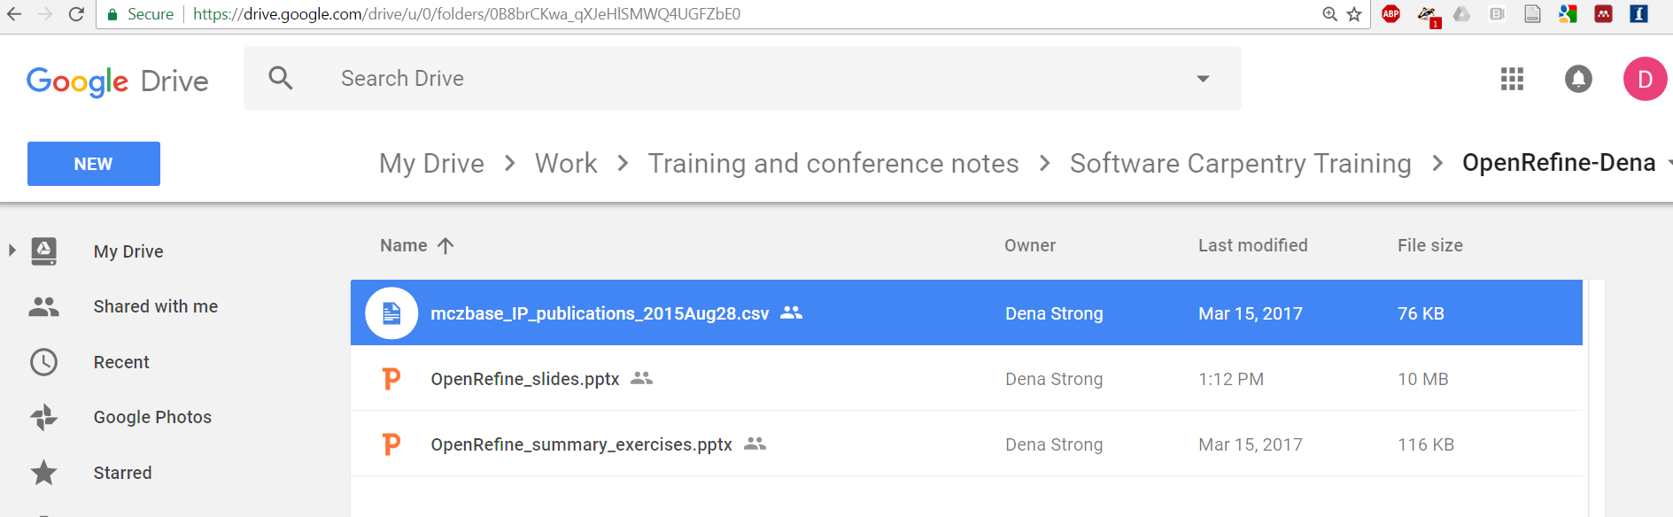
Locate the dataset
http://tinyurl.com/dc-openrefine-csv
Notes:
-- overview: next slide

Slide 7
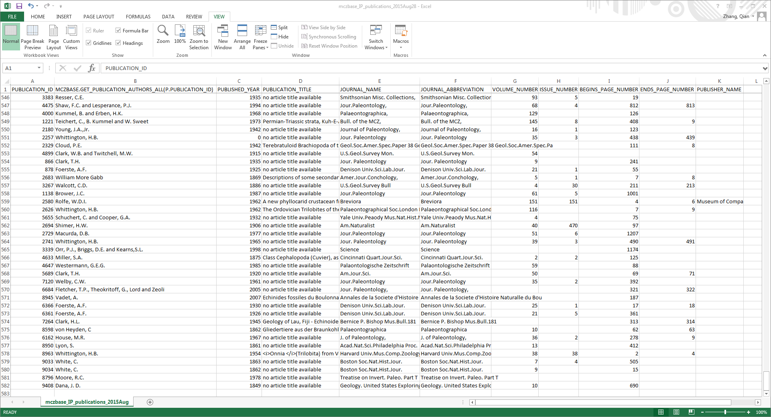
Overview of the Dataset
Notes:
Bottom line: All data need to be analyzed and cleaned. The bigger the dataset, the greater the likelihood of error. Data quality is fundamental to data curation.
Brainstorming_logs, observation,
MCZBASE: Harvard Museum of Comparative Zoology, A database of the zoology collection, retrieved from SQL database where pulication_id is not null.
step 1: overview,
581 rows x 11 columns
- 6 numeric columns:
(1). column 1: PUBLICATION_ID
(2). column 3: PUBLISHED_YEAR
OP: 164 choices, including 1 (0) and 1 (blank), spanning 1832-2010
(3). column 7: VOLUME_NUMBER
OR: 130 choices, including 124 (blank)
(4). column 8: ISSUE_NUMBER
OR: 72 choices, including 236 (blank)
(5). column 9: BEGINS_PAGE_NUMBER
OR: 349 choices, including 35 (blank)
(6). column 10: ENDS_PAGE_NUMBER
OR: 157 choices, including 349 (blank)
constraints:
(1). publication id should be unique in column 1: satisfied
(2). BEGINS_PAGE_NUMBER <= ENDS_PAGE_NUMBER: column 9 <= column 10
- 5 text columns:
(1). column 2: MCZBASE.GET_PUBLICATION_AUTHORS_ALL(P.PUBLICATION_ID)
OpenRefine (OR): 314 choices, including 1 (no agent data)
(2). column 4: PUBLICATION_TITLE
OR: 127 choices, including 454 (no article title available)
(3). column 5: JOURNAL_NAME
OR: 312 choices, cluster (key collision): 312 choices -> 290 choices
(4). column 6: JOURNAL_ABBREVIATION
OR: 311 choices, cluster (key collision): 311 choices -> 287 choices
(5). column 11: PUBLISHER_NAME
OR: 1 choice, including 579 (blank)
constraints:
(1). column 2: Last, First initial consistency
OR cluster->method (key collision)->single authors: 314 choices -> 310 choices
OR cluster -> method (nearest neighbor), distance function (levenshtein), radius (1.0), block chars (6): 310 choices -> 307 choices
(2). column 4: complete missing titles
(3). column 5: journal name should be full name rather than abbreviation, thus at least equal or longer than journal abbreviation in column 6
(4). column 6: journal abbreviation should be abridged, thus at least equal or shorter than journal name in column 5
(5). complete missing publisher name

Slide 8
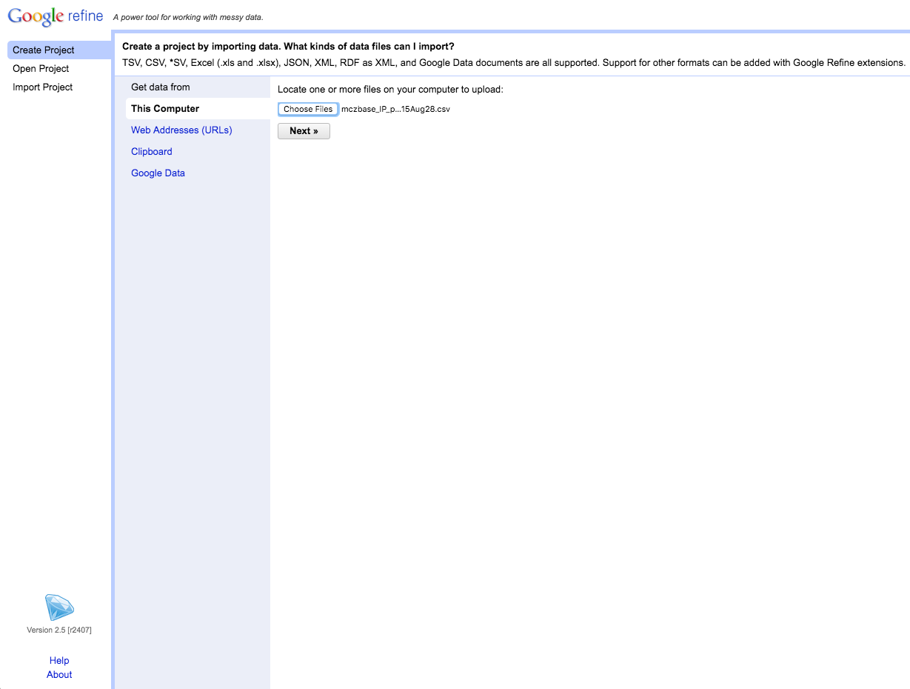
Creating a Project
Notes:
-- Start the program. (Double-click on the google-refine application. Java services will start on your machine, and Refine will open in your web browser). If Open Refine does not open in a browser window, open your browser and type the address http://127.0.0.1:3333/ to take you to the Open Refine interface.
-- Choose create project (notice that you can also open projects you’ve worked on previously or import projects. The import feature is especially useful for collaboration). There are several options for getting your data set into OpenRefine. You can upload or import files in a variety of formats including: TSV (tab-separated values), CSV (comma-separated values), Excel JSON (javascript object notation), XML, Google Spreadsheet, etc.
-- Upload “mczbase_IP_publications_2015Aug28.csv”. Caveat: OpenRefine can get pretty slow if you ingest too many records, aka. the very large data file. But It’s possible to allocate additional memory to Open Refine when working with large datasets, but not for the purposes of this demo. If this is important to you, we can discuss it after the basics hands-on session.
-- The next screen gives you some options to ensure that the data gets imported into OpenRefine correctly.

Slide 9
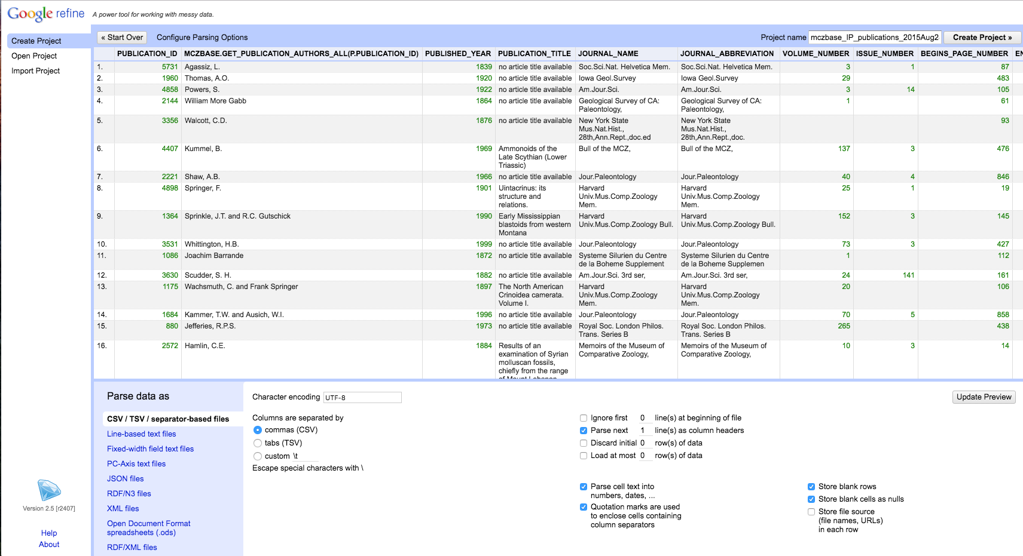
Creating a Project
Notes:
-- Use the preview window to review the data
-- Notice the parse options. The options vary depending on the type of data you are importing. for this data set, be sure that:
---- Set the ‘Character encoding’ to ‘UTF-8’
---- Columns are set as CSV
---- Ensure the first row is parsed as the column header
---- Make sure OpenRefine (doesn’t) tries to automatically detect numbers and dates, in this case 6 columns are highlighted in green as numeric.
--- note quotation marks option. In this case, we have it checked, but if you use quotations in your data set for other purposes it may cause parsing issues
-- When you selected among options, click “update preview”, review again, and if all looks well, choose a project name and click “create project >>”
-- This will create the project and open it for you. Projects are saved as you work on them, there is no need to save copies as you go along.
To open an existing project in OpenRefine you can click ‘Open Project’ from the main OpenRefine screen (in the left hand menu). When you click this, you will see a list of the existing projects and can click on a project’s name to open it.
-- key points:
---- Use the 'Create Project' option to import data
---- You can control how data imports using options on the import screen
-- exercise1 time:
---- Give 4 mins for students to feel the difference among above options
---- in the meanwhile, create a log.txt in your laptop, try to document the options you’ve finally made when importing the data

Slide 10
The Layout of OpenRefine
OpenRefine displays data in a tabular format. Each row will usually represent a ‘record’ in the data, while each column represents a type of information. This is very similar to how you might view data in a spreadsheet or database.
OpenRefine only displays a limited number of lines of data at one time. You can adjust the number choosing between 5, 10 (the default), 25 and 50.

Slide 11
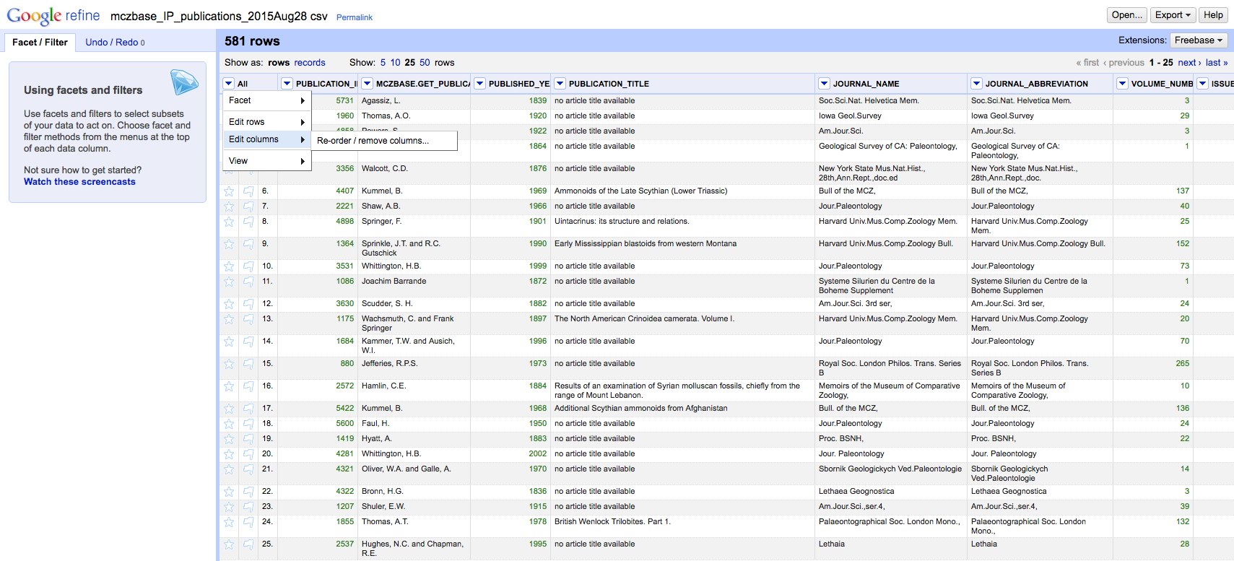
Reordering and Removing Columns
Notes:
-- Reordering and renaming columns
---- Many operations in OpenRefine are accessed from the drop down menus at the top of each column. You can re-order the columns by clicking the drop down menu at the top of the first column (labelled ‘All’), and choosing ‘Edit columns->Re-order / remove columns …’
---- You can then drag and drop column names to re-order the columns, or remove columns completely if they are not required.

Slide 12
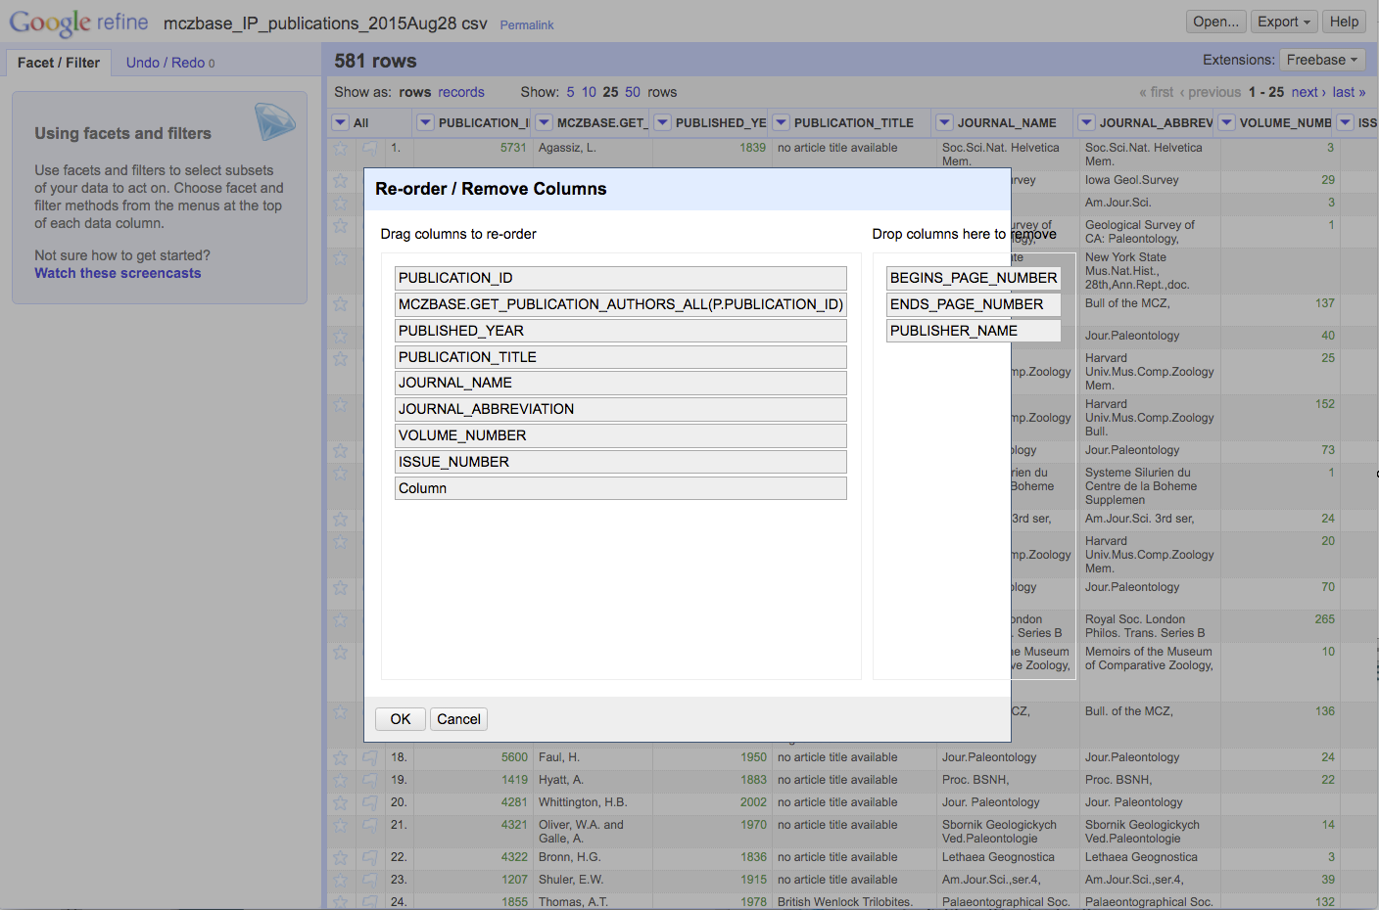
Reordering and Removing Columns
Notes:
Example: Move Publication Year after Publication Title. Also, there’s nothing in the Column field, so you can drag it to remove.

Slide 13
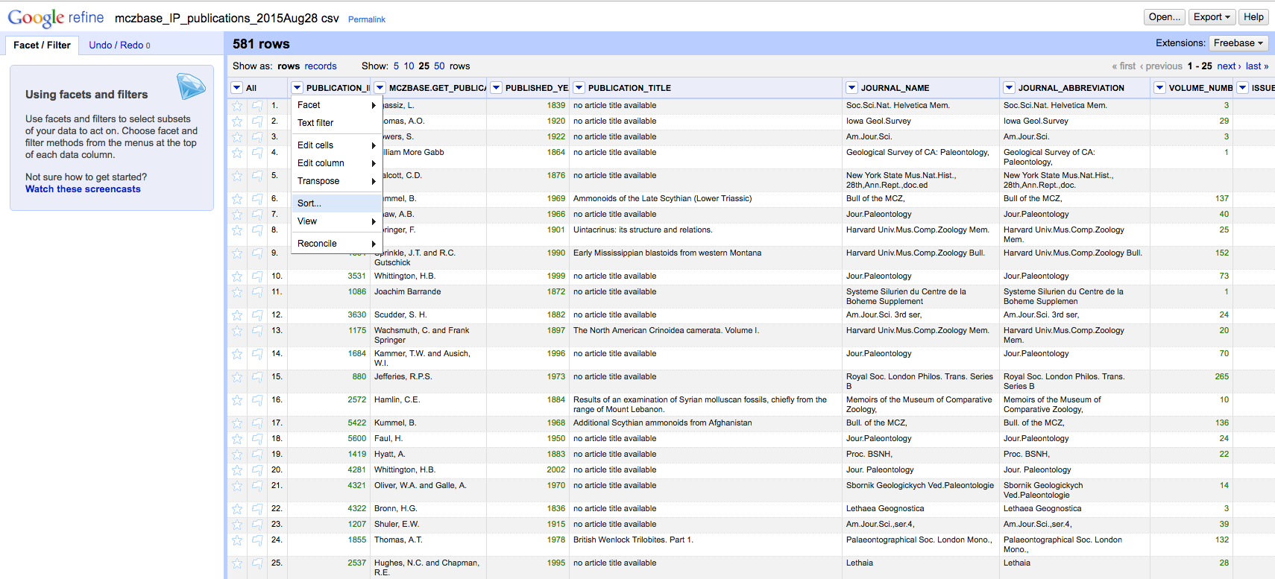
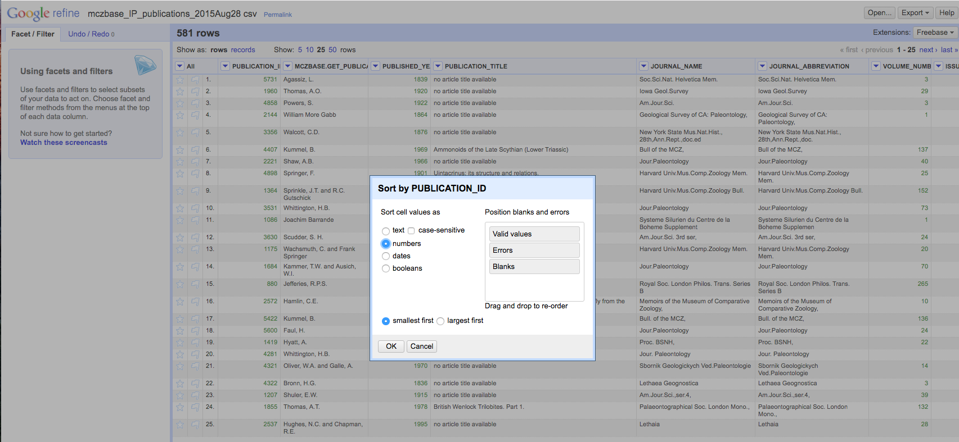
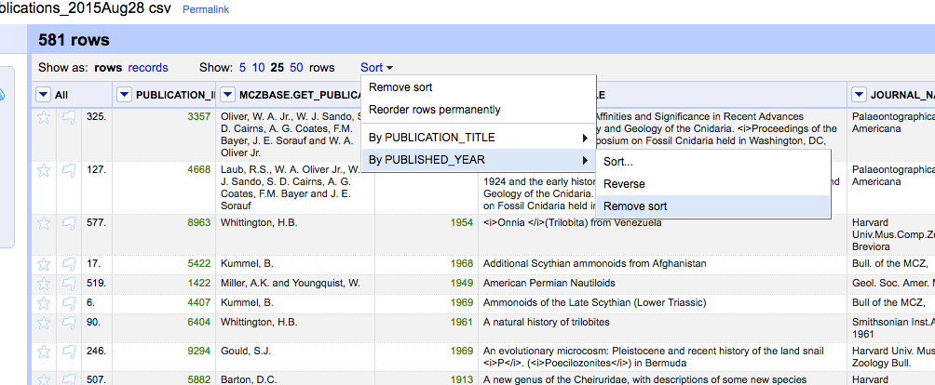
Sorting Data
`
Notes:
-- sorting data
---- You can sort data in OpenRefine by clicking on the drop down menu for the column you want to sort on, and choosing ‘Sort’
---- Once you have sorted the data, a new ‘Sort’ drop down menu will be displayed.
---- Unlike Excel, ‘Sorts’ in OpenRefine are temporary - that is, if you remove the ‘Sort’, the data will go back to it’s original ‘unordered’ state. The ‘Sort’ drop down menu lets you amend the existing sort (e.g. reverse the sort order), remove existing sorts, and make sorts permanent.
---- You can sort on multiple columns at the same time by adding another sorted column (in the same way).
-- exercise2 time: Give 5 mins for students to try reorder, rename, and sorting. for sorting, pick 3 columns (at least 1 numeric and 1 text column), sort those columns the way you prefer, in the meanwhile, keep documenting in your log.txt, try to record the operations/steps you did after importing the data, e.g., which columns are removed when reordering? What is the new order? Which column is sorted? based on which criteria? E.g., text/numbers/dates/booleans?

Slide 14
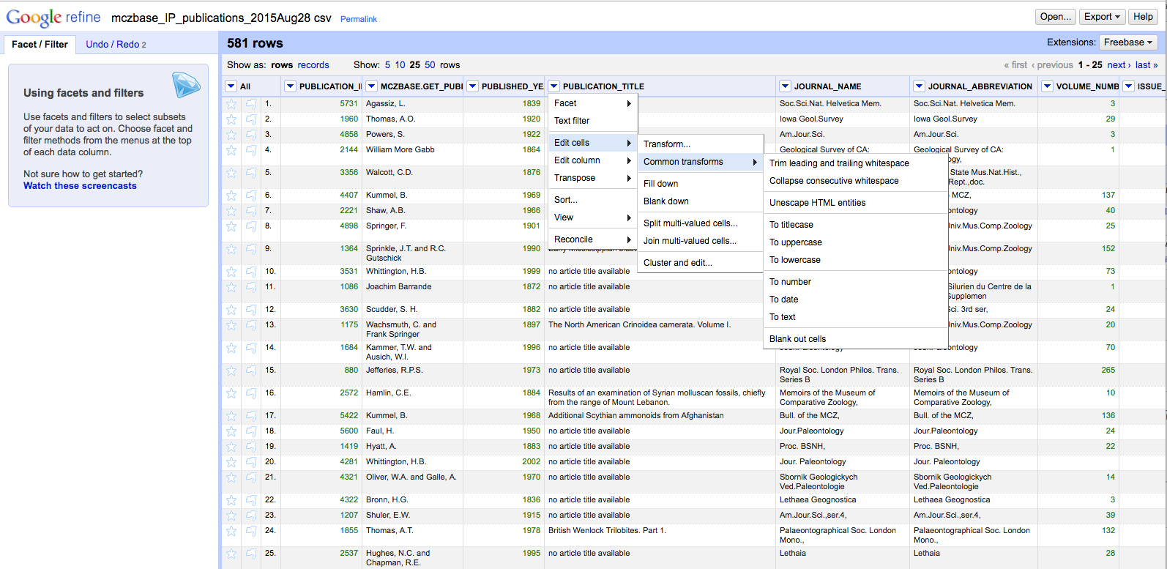
Basic Normalization
Notes:
-- click the arrow to the left of PULICATION_TITLE for a drop-down menu
-- choose edit cells
-- choose common transforms
-- start by trimming whitespace (you’ll notice that 6 cells were effected)
-- collapsing whitespace effects another 1 cells. Computers are better than humans at detecting white space.
-- also play with uniformly setting the cases

Slide 15
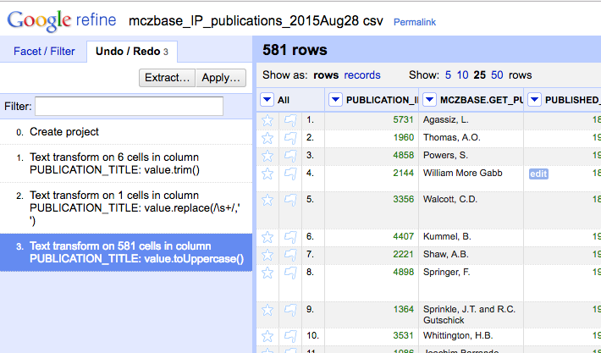
A Note on Tracking Project History
Don’t be afraid to make mistakes!
…you can always use the Undo/Redo tab to navigate to earlier stages in your project.
Notes:
-- Caveat: if you choose to navigate backward in your project history, you won’t be able to access any steps you’d taken after that point once you’ve made another change.
-- How to undo/redo operations?
---- Any operation in OpenRefine that changes the data can be undone. Changes are tracked from the very beginning when a project is first created. The undo/redo change history of each project is saved together with the project's data, so closing down your browser and quitting OpenRefine does not disturb the history. When you restart OpenRefine, you can still undo changes that you had made before you closed down your browser and/or quit OpenRefine.
---- the simplest way is whenever right after you performed an operation, there will be showing a notification in yellow on the top of the webpage, saying how many cells have been affected. And a “undo” button shows altogether. You can quickly undo the latest operation by clicking “undo”. However this notification only lasts for a very short time and then will disappear. If you haven’t made up your mind and miss that button, don’t worry! you can always go to the history of all actions you’ve made and undo them.
---- The history is shown as a list of indexed changes, with the first "change" being the action of creating the project itself. (That first change, indexed zero, cannot be undone.)
---- There should be exactly one change with a blue background. That is the last performed change. The state of the project is when that change has just been performed.
---- To revert the state of the project to after some change X has been done, click on X in the history. For example, in the sample history above, suppose we only want to perform all changes up to and including action #1 (“text transform on 6 cells in column PULIBCATION_TITLE”), then click on "text transform on 6 cells in column PULIBCATION_TITLE". The last 2 changes will be undone in order to bring the project back to state #1.
---- When you've undone some changes, then they are grayed out. In this example, changes #2 and #3 will be grayed out. You can redo up to and including a change by clicking on it in the history. Once you execute a new operation however, all the remaining changes from the redo stack will be cleared and are no longer available.

Slide 16
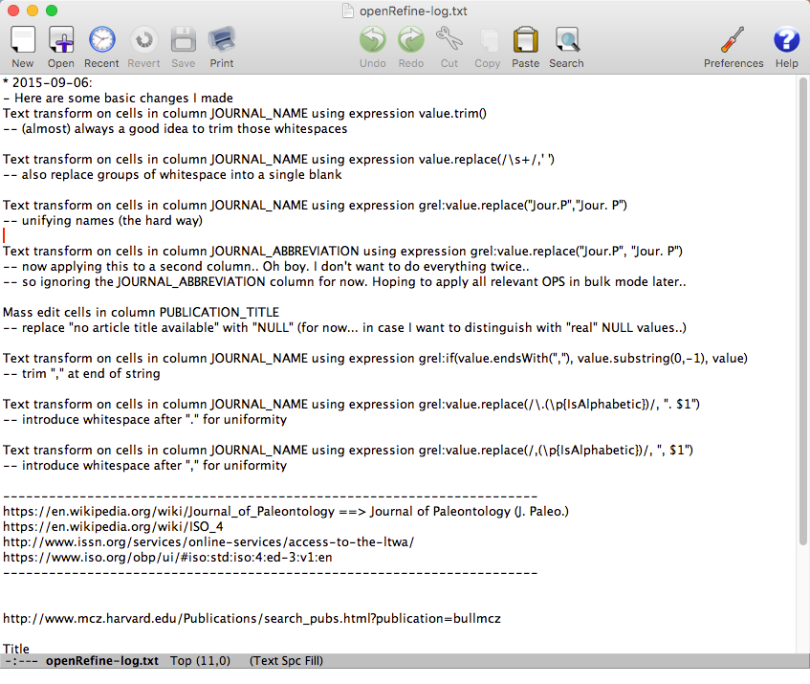
Another Level of History: What exactly? Why? What for?
Notes:
-- Now this is another reason for keeping a documentation in log.txt, so that all your ideas and operations and ideas will be recorded in English (human-readable language). Also very helpful for reproducibility of your work in the future!
---- Because the history alone, especially when there are too many operations, will confuse yourself. E.g., if you just do the same text transform for trimming leading and trailing whitespaces for multiple (say 10) columns. In OpenRefine history, there will be 10 such operations records. However in YOUR log.txt, you can just write all of these within one line: say “text transform for trimming leading and trailing whitespaces for 10 columns, they are A,B,C…”, which is space saving and easier to understand, especially for batch processing.
-- exercise3 time: Give 5 mins for students to try basic normalization. You can randomly pick 2 columns (1 numeric and 1 text column), perform two different basic normalization to the 2 columns based on your preference, in the meanwhile, keep documenting in your log.txt, try to record the operations/steps you did, and compare your log.txt with the history that is automatically tracked by OpenRefine. Try to understand the difference. And as a homework1, review these two “log” files again after three days and see how much you long each takes you to refresh your memory on the motive of performing those operations.

Slide 17
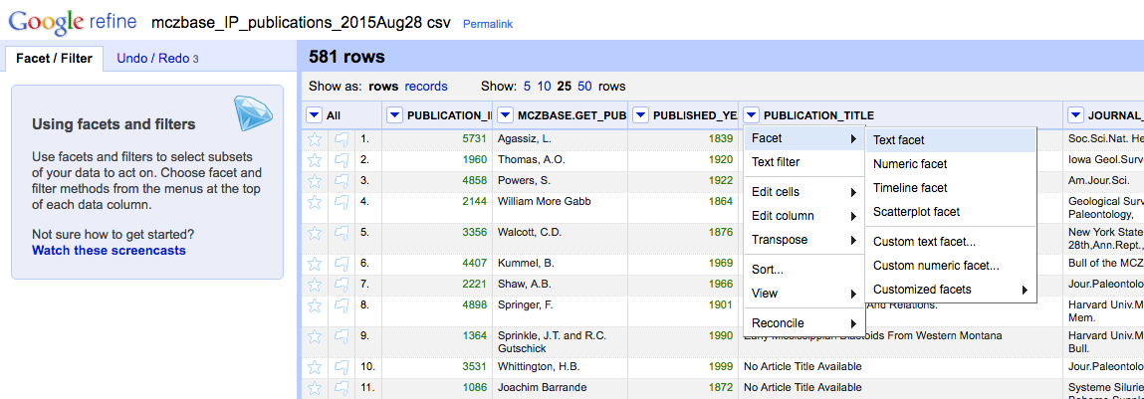
Faceting and Clustering - Faceting
Notes:
-- Navigation to “Facet → Text facet”
-- Facets are one of the most useful features of OpenRefine. It can help get an overview of the data in a project, in the meanwhile, help you bring more consistency to the data.
-- A ‘Facet’ groups all the values that appear in a column, and then allow you to filter the data by these values and edit values across many records at the same time.
-- The simplest type of Facet is called a ‘Text facet’. This simply groups all the text values in a column and lists each value with the number of records it appears in. The facet information always appears in the left hand panel in the OpenRefine interface.
-- To create a Text Facet for a column, click on the drop down menu at the top of the column and choose ‘Facet -> Text Facet’. The facet will then appear in the left hand panel.
-- The facet consists of a list of values used in the data. You can filter the data displayed by clicking on one of these headings.
-- You can include multiple values from the facet in a filter at one time by using the ‘Include’ option which appears when you put your mouse over a value in the Facet.
-- You can also ‘invert’ the filter to show all records which do not match your selected values. This option appears at the top of the Facet panel when you select a value from the facet to apply as a filter.
-- Amending data through facets
---- If you create a text facet you can edit the values in the facet to change the value for several records at the same time. To do this, simply mouse-over the value you want to edit and click the ‘edit’ option that appears.
---- This approach is useful in relatively small facets where you might have small variations through punctuation or typing errors etc. For example, a column that should contain only terms from a small restricted list such as days of the week or months of the year.
---- The list of values in the facet will update as you make edits.

Slide 18
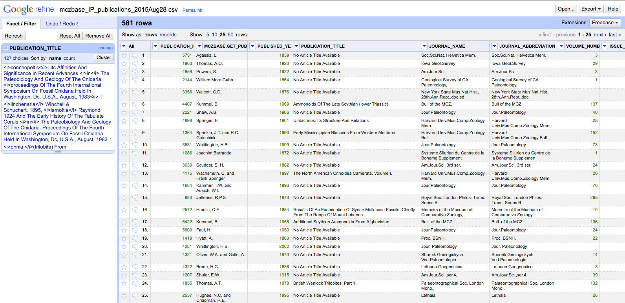
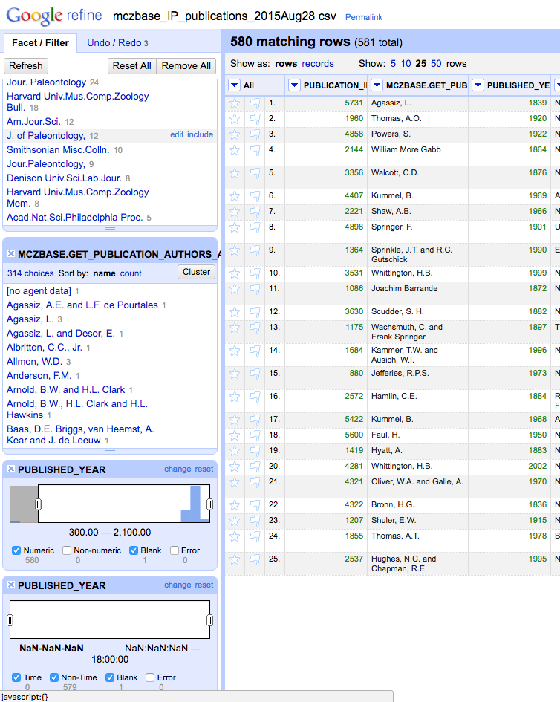
Faceting and Clustering - Faceting
Notes:
-- more on Facets
---- As well as ‘Text facets’ Refine also supports a range of other types of facet. These include:
---- Numeric facets
---- Timeline facets (for dates)
---- Custom facets
---- Scatterplot facets
---- Numeric and Timeline facets display graphs instead of lists of values. The graph includes ‘drag and drop’ controls you can use to set a start and end range to filter the data displayed.
---- Scatterplot facets shows the relationships between all of the numeric values in each of the columns.
Scatterplot facets are less commonly used - for further information on these see the tutorial athttp://enipedia.tudelft.nl/wiki/OpenRefine_Tutorial#Exploring_the_data_with_scatter_plots.
---- Custom facets are a range of different types of facets, and also allow you write your own custom facets. Some of the default custom facets are:
---- Word facet : this breaks down text into words and counts the number of records each word appears in
----- Duplicates facet: this results in a binary facet of ‘true’ or ‘false’. Rows appear in the ‘true’ facet if the value in the selected column is an exact match for a value in the same column in another row
---- Text length facet: creates a numeric facet based on the length (number of characters) of the text in each row for the selected column. This can be useful for spotting incorrect or unusual data in a field where specific lengths are expected (e.g. if the values are expected to be years, any row with a text length more than 4 for that column is likely to be incorrect)
---- Facet by blank - a binary facet of ‘true’ or ‘false’. Rows appear in the ‘true’ facet if they have no data present in that column. This is useful when looking for rows missing key data.
---- Facets are intended to group together common values and OpenRefine limits the number of values allowed in a single facet to ensure the software does not perform slowly or run out of memory. If you create a facet where there are many unique values (for example, a facet on a ‘book title’ column in a data set that has one row per book) the facet created will be very large and may either slow down the application, or OpenRefine will not create the facet.

Slide 19
Filters
As well as using Facets to filter the data displayed in OpenRefine you can also apply ‘Text Filters’ which looks for a particular piece of text appearing in a column. Text filters are applied by clicking the drop down menu at the top of the column you want to apply the filter to and choosing ‘Text filter’.
As with Facets, the Filter options appear in the left hand panel in OpenRefine. Simply type in the text you want to use in the Filter to display only rows which contain that text in the relevant column.
- You can also use regular expressions in the filter.
Notes:
-- exercise4 time: Give 5 mins for students to faceting and filtering. You can randomly pick 2 columns (1 numeric and 1 text column), perform facet operation to the 2 columns. Try to answer the following questions: 1). What is the most common data value in the individual column? 2). How many of each in the file don’t have a value (blank, ”no article title available”, “no agent data” assigned? 3). Try numeric facet and text facet on a numeric column. See the difference. 4). Use the ‘Facet by blank’ function to find all publications in this data set without a PUBLICATION_TITLE? What about JOURNAL_NAME? 5). Correct the Language values via a facet: Create a Text facet on the JOURNAL_NAME column➔ Notice that there are ‘Jour.Paleontology’ and ‘Jour. Paleontology’, ‘JOUR.PALEONTOLOGY,’, ‘Palaeontographica’, ‘PALAEONTOGRAPHICA,’, and ‘Palaeontographica,’ ➔ Put the mouse over the 5 values ➔ Click ‘Edit’ ➔ Type ‘Jour.Paleontology’ and click ‘Apply’. See how the Language facet updates
again, keep documenting in your log.txt, try to record the changes/operations/steps you did.

Slide 20
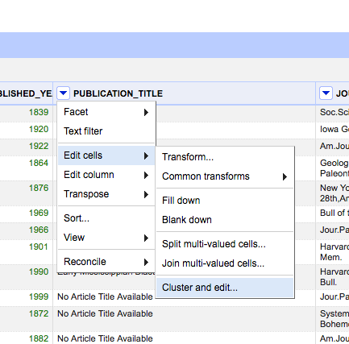
Faceting and Clustering – Clustering
Notes:
-- Besides using Facets to edit data values for consistency purpose (exercise 4), clustering is also very good at this.
-- The Cluster function groups together values in a column that are ‘similar’ and enables you to merge together several different, but similar, values into a single value.
-- This is very effective where you have data where there can be minor variations in data values that are likely such as names of people, organizations and places.
-- To use the ‘Cluster’ function,
---- way 1) Click “Cluster” from Facet on the left hand panel in the OpenRefine interface
---- way2) click on the ‘Edit Cells’ menu option in the relevant column and choose ‘Cluster and edit…

Slide 21
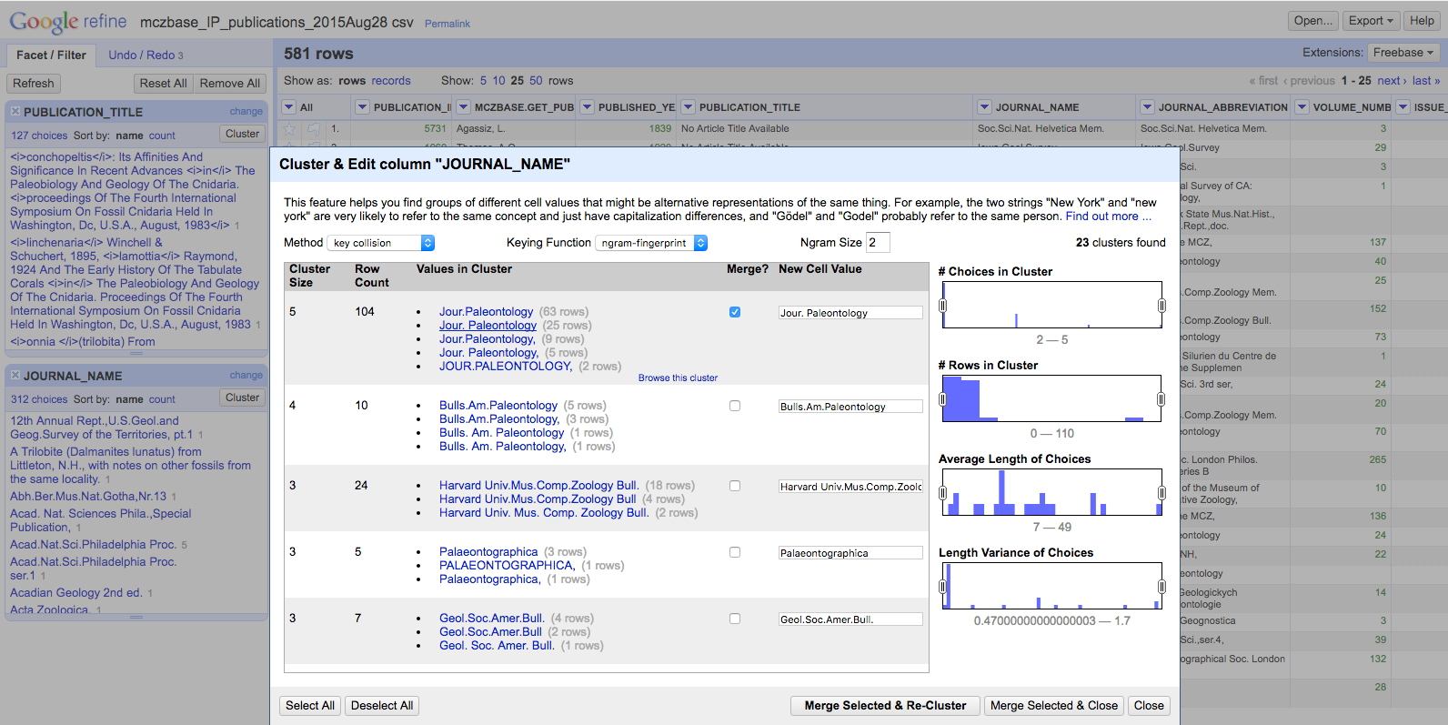
Faceting and Clustering -Clustering
Notes:
-- The ‘Clusters’ are created automatically according to an algorithm. Note that there are a few different methods/algorithms supported by OpenRefine that you can try, and they will return different results. I encourage you to play around with those settings and see which clustering algorithm works best with any particular column/set of data of your own dataset. And you may find that using different algorithms highlights different clusters.
---- For more information on the methods used to create Clusters, see https://github.com/OpenRefine/OpenRefine/wiki/Clustering-In-Depth
-- For each cluster, review the values in the cluster, and (where needed) determine the preferred cell value. You have the option of ‘merge’ the values together by selecting the “Merge?” check box. That is to replace with a single consistent value. By default OpenRefine uses the most common value in the cluster as the new value, but you can select one of the other values by clicking the value itself, or you can simply type the desired value into the ‘New Cell Value’ box.
-- Then select “Merge Selected and Re-Cluster”

Slide 22
Kinds of Clustering
Key collision (fastest, safest)
Fingerprint, Ngram Fingerprint = defaults
Match normalized strings in different ways
Metaphone = English pronunciation
Nearest Neighbor (takes longer time to calculate, so not used very ofen).
PPM = Partial matching
Levenshtein = edit distance
Notes:
---- For more information on the methods used to create Clusters, see https://github.com/OpenRefine/OpenRefine/wiki/Clustering-In-Depth

Slide 23
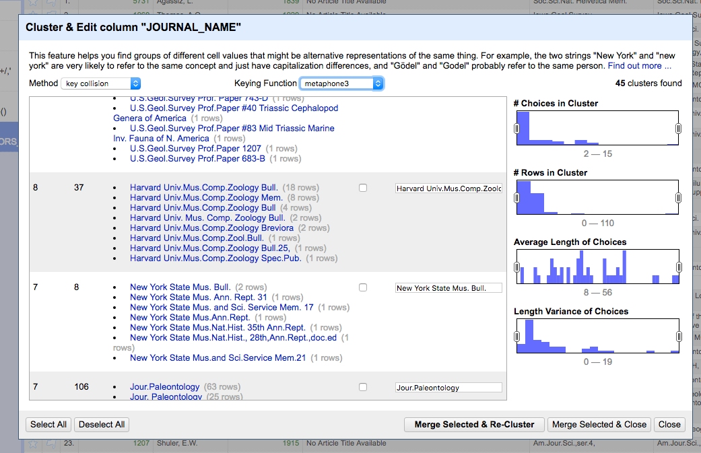
Sub-clustering
Notes:
If you hover over a section, a Browse This Cluster link will appear, and that will let you get a closer look at exactly what’s contained in this cluster (shown in next slide).

Slide 24
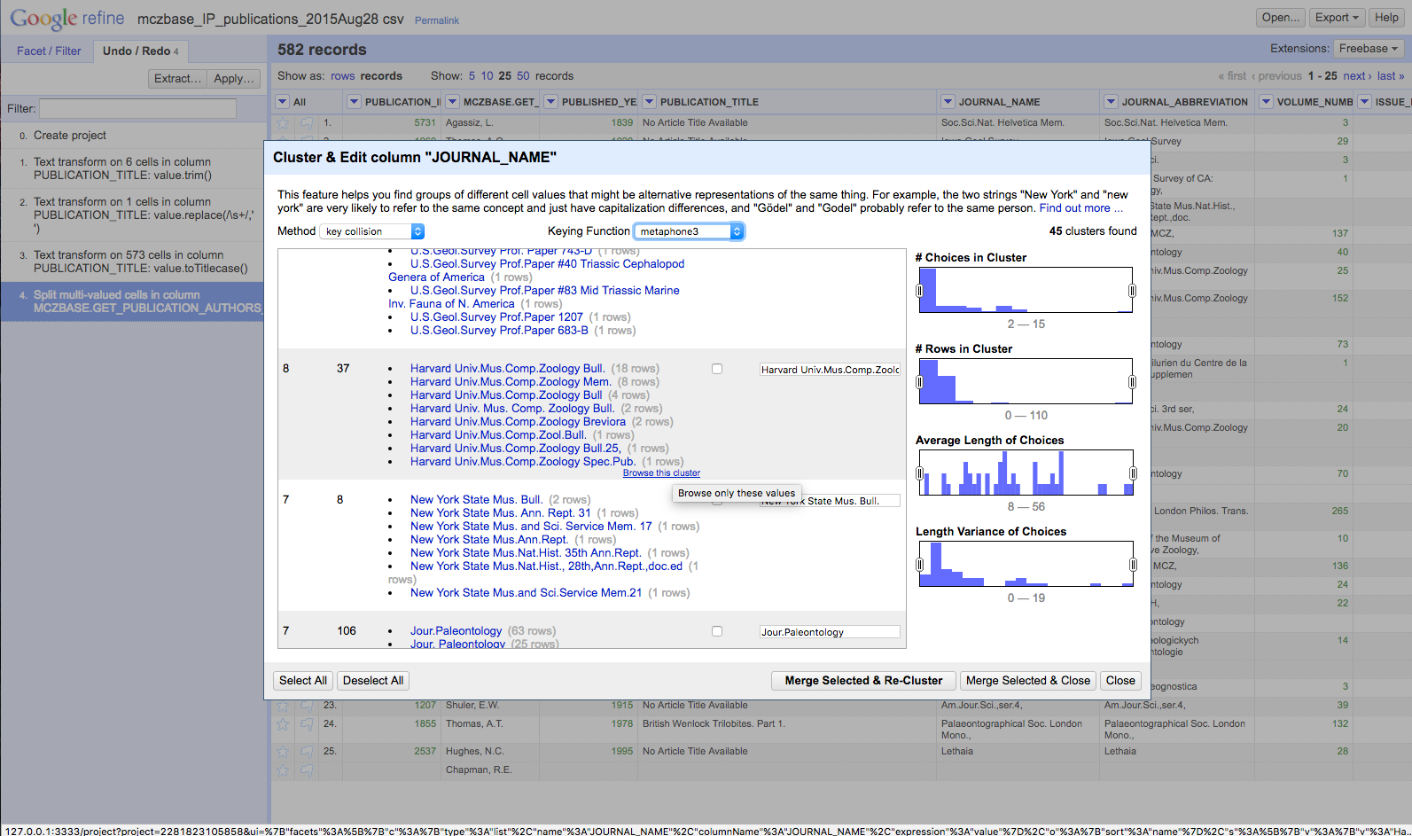
Sub-clustering

Slide 25
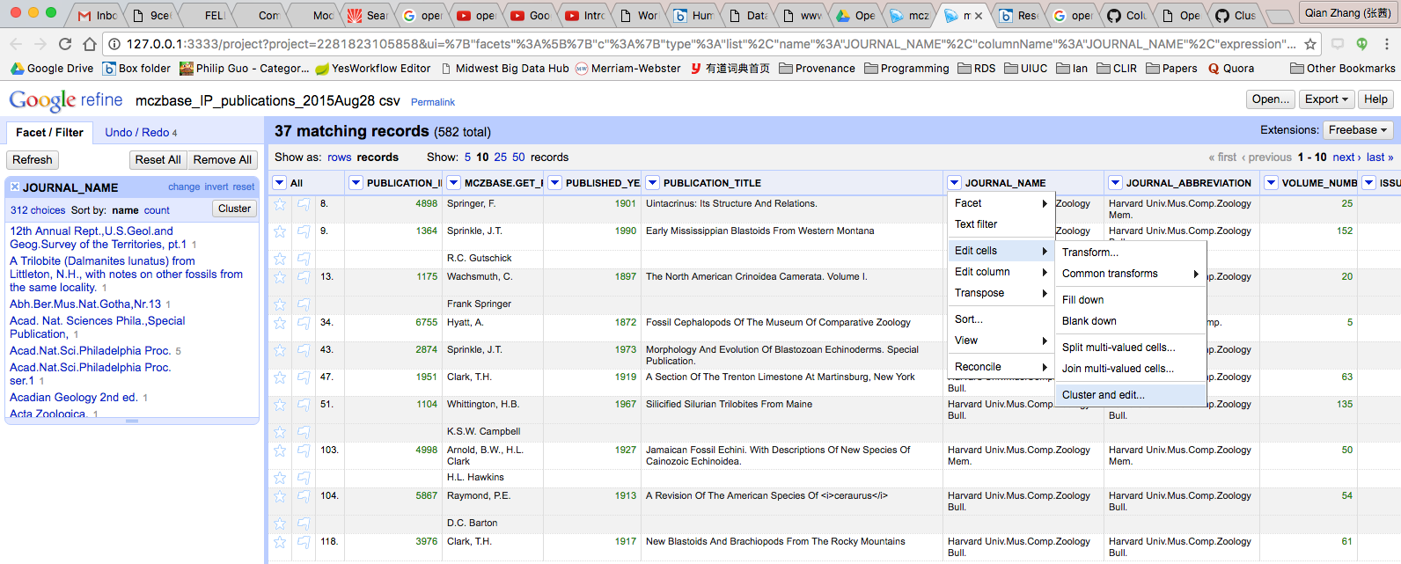
Sub-clustering
Notes:
This is another way to get at a similar cluster editing option without going through the facet view first.

Slide 26
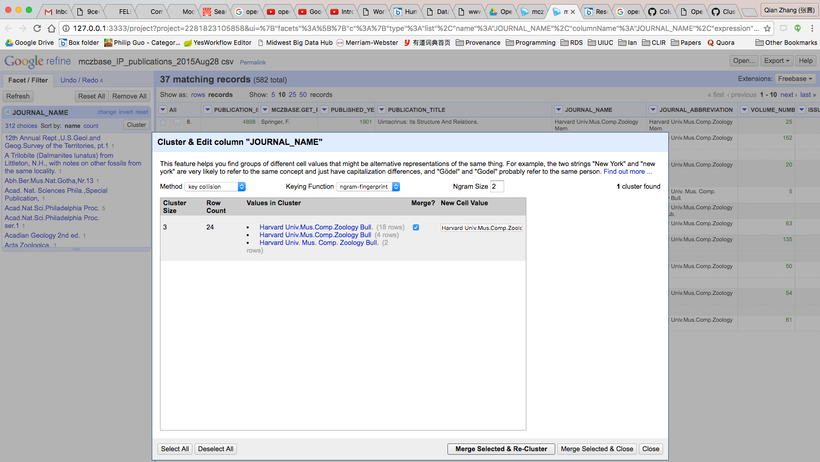
Sub-clustering
Notes:
-- exercise5 time: Give 5 mins for students to use Clustering to clean up JOURNAL_NAME data.
Choose ‘Edit cells-> Cluster and edit’ from the JOURNAL_NAME column.
Step1). Using the ‘key collision’ method with the ‘fingerprint’ Keying Function work through the clusters of values, merging them to a single value where appropriate
Step2). Try changing the keying function to “ngram-fingerprint”, how does it work?
Step3). After that, try changing the keying function to “Metaphone3”, how does it work?
step4). How about “cologne-phonetic?” which ones work best?
Step5). How about sub-clustering?
---- again, keep documenting in your log.txt, try to record the method/keying functions you picked.

Slide 27
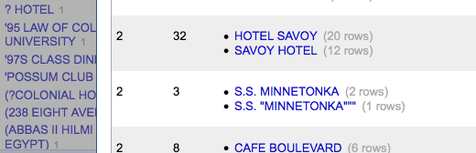
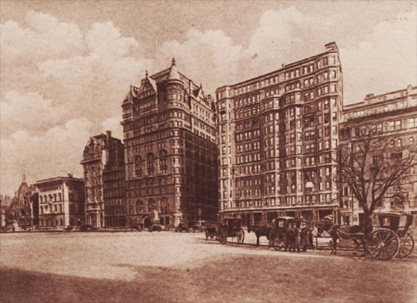
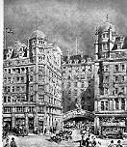
Clustering Caveat
Hotel Savoy
59th St. & 5th Ave.
New York, New York
Savoy Hotel
Strand
London WC2R 0EU
United Kingdom
Notes:
Just because their names are similar doesn’t mean they’re the same!
-- Today the Hotel Savoy is an Apple Store. The Savoy Hotel, famous for its cocktails, is still in operation.

Slide 28
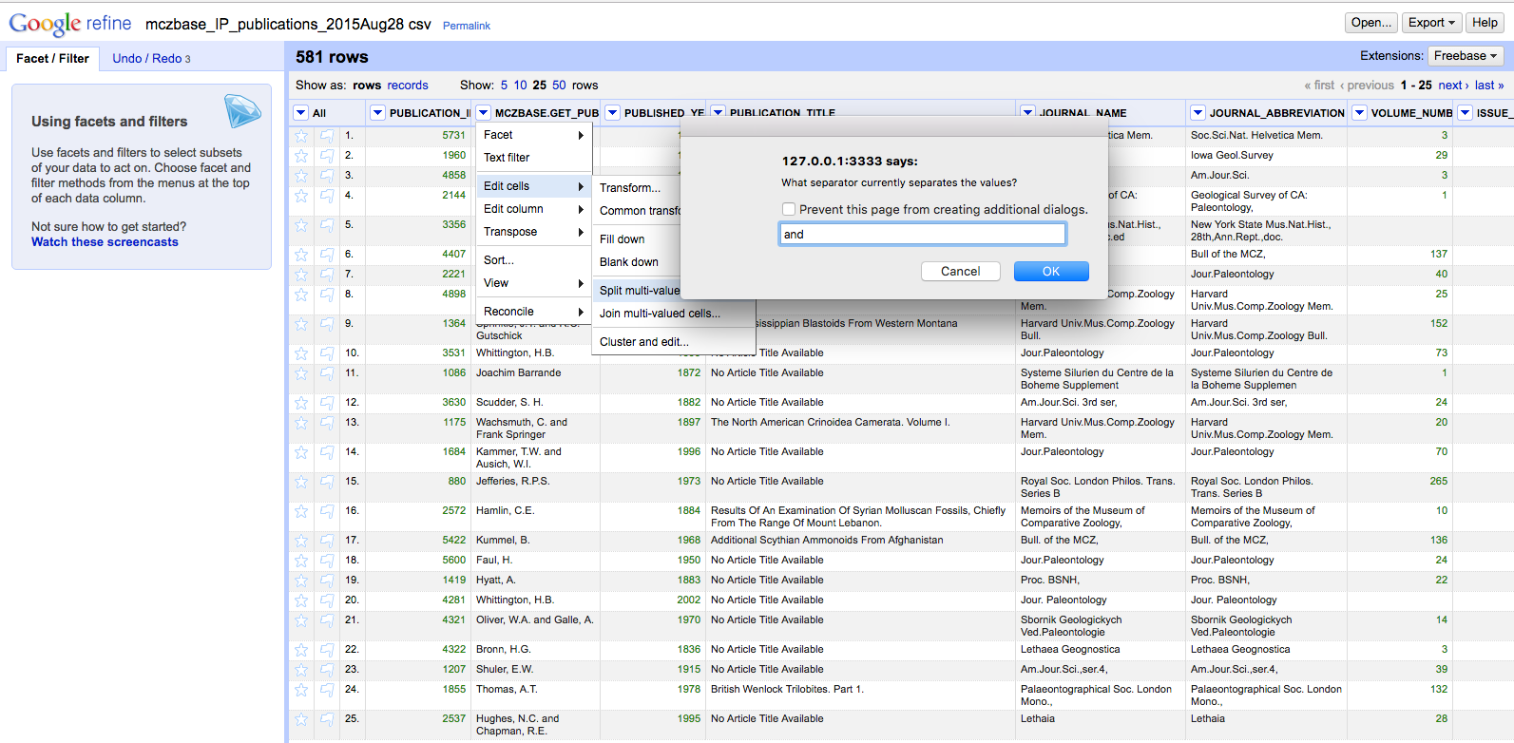
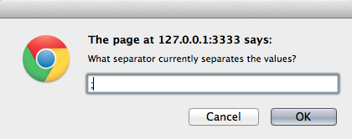
Records vs. Rows
Notes:
-- OpenRefine has two modes of viewing data ‘Rows’ and ‘Records’. So far we’ve been using the Rows mode, where each row represents a single record in the data set - in this case, an article. In Records mode, OpenRefine can link together multiple rows as belonging to the same Record.
Time for flashback to Spreadsheets lesson: Duplicate your column before applying transformations on it so that you have a clean point of comparison! (Incredibly easy mistake to make: No spaces around ‘and’ – which will break the record in the middle of people’s names if the character string ‘and’ happens in the middle of a name.)
-- How this works can be seen in the next exercise…

Slide 29
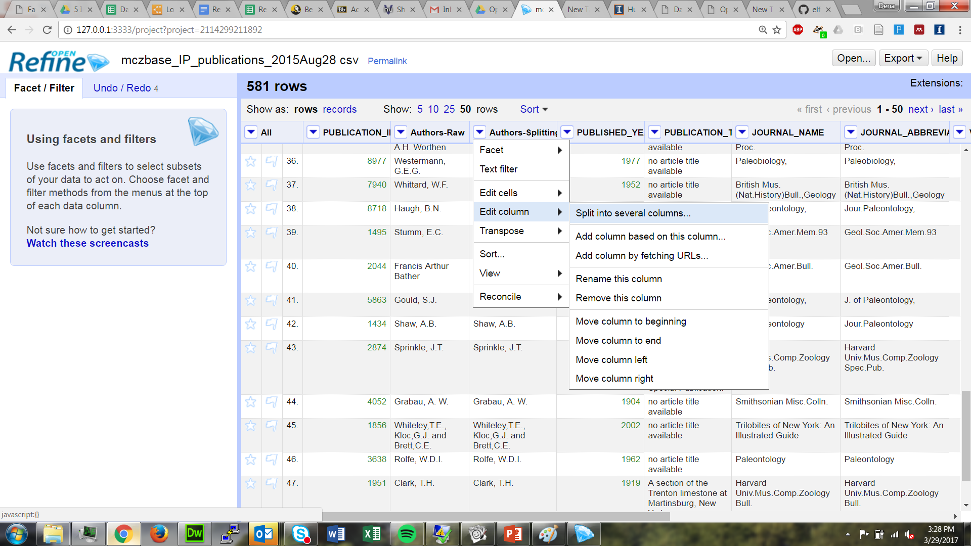
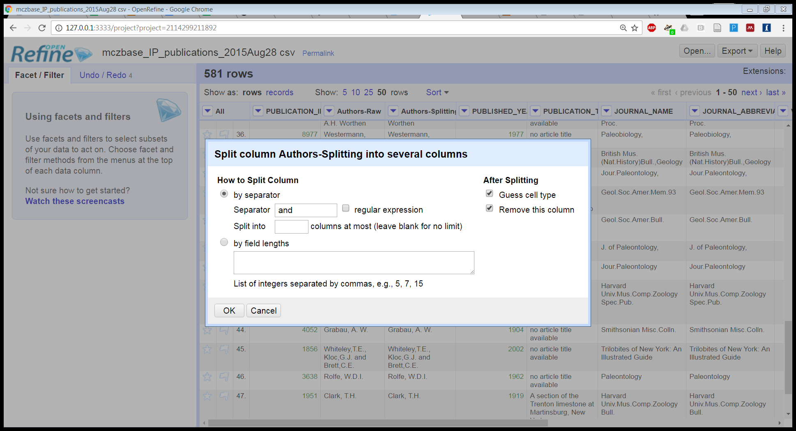
Splitting into columns
Notes:
This takes care of everything with two entries, but what about three or more entries?
----- exercise6 time: Give 5 mins for students to split author names into separate cells. multivalued cells occur when many kinds of data are stuffed into a single cell. If you look at the Author column you should be able to see that there are multiple names in each cell separated by the word “and” (also could be any other symbol, e.g., ‘,’, ‘;’, ‘|’,…). Row #13 with PUBLICATION_ID=1175, “Wachsmuth, C. and Frank Springer” as name, for example, could be split into two cells (first author, second author, …).
Setup: No sorts applied, 50 rows visible
Gotchas: author name Barrande – if you end up with 3 split rows and one has just the letter E, you need spaces around ‘and’
Multiple authors – only the ‘and’ was successfully split upon before; row 45 (entry 45) has 3 authors.
You know the last one is isolated, so the remaining combos will be in the first, not the second, column.
Dot-comma will split people who have initials but will also split ‘junior’ and ‘et al’ – and what about the instances with spelled out names? Sometimes no dots, sometimes no commas,… hard nut to crack.
Entry 127 (row 161 after a vertical split) has 7 authors… how to attack that one? Both horizontal and vertical splits find one and stop. Answer is likely recursion and complex conditionals – excluding Jr from a split condition, identifying joins that aren’t initials by having the comma preceded by a non-capitalized letter…
To work with the author names effectively we need to split them into separate cells: Click the dropdown menu at the top of the Author column → Choose ‘Edit cells->Split multi-valued cells’ → In the prompt type the “and” symbol and click ‘OK’ (Note that the rows are still numbered sequentially) → to review the different between records and rows, beginning by splitting some multi-valued cells: Click the ‘Records’ option to change to Records mode. Note how the numbering has changed - indicating that several rows are related to the same record.
---- again, keep documenting in your log.txt, try to record the separator/changes/operations/steps you did.
-- exercise7 time: Give 5 mins for students to Use Clustering to clean up author data. Choose ‘Edit cells->Cluster and edit’ from the author column (which should be split into individual values from the last exercise). Using the ‘key collision’ method with the ‘fingerprint’ Keying Function work through the clusters of values, merging them to a single value where appropriate. Try changing the clustering method being used - which ones work well?

Slide 30
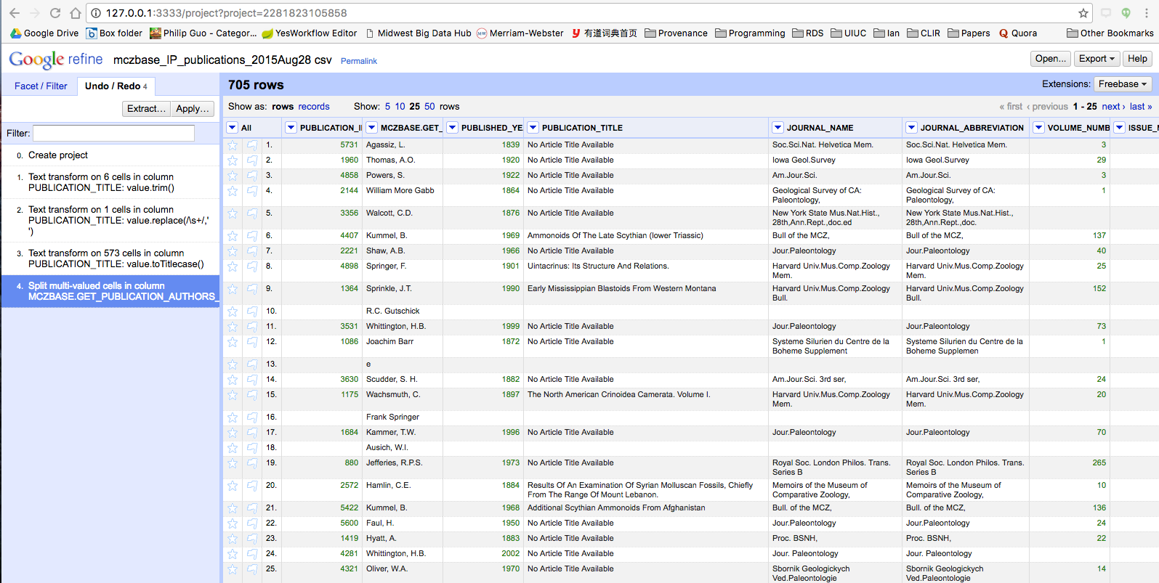
Multiple Values, Multiple Rows
Notes:
This is good if you’re only interested in specific values from the physical description, like whether or not menus are illustrated.
BUT, notice how the rest of rows 16 is blank .

Slide 31
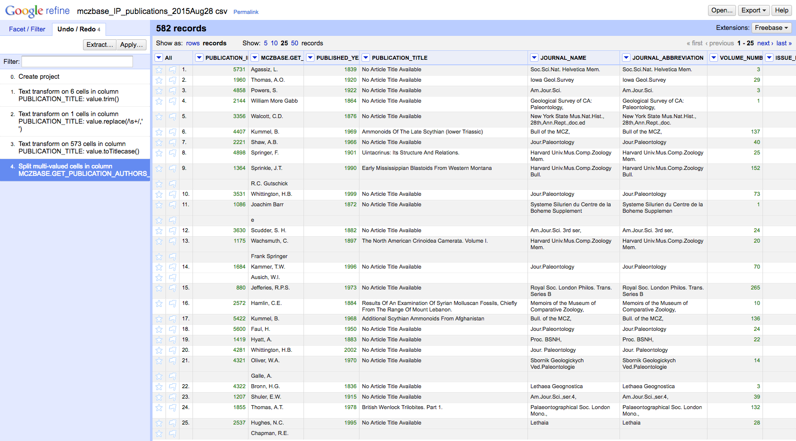
One Record, Multiple Rows
Notes:
Switching to the records view gives you the flexibility of gathering multiple rows together under the same ID.

Slide 32
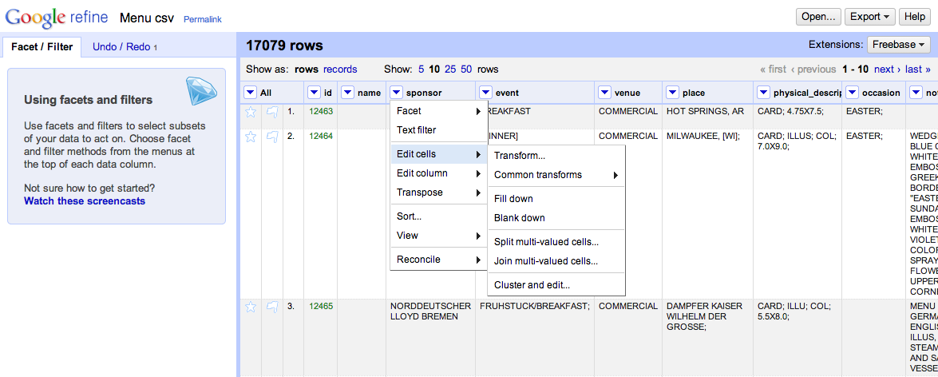
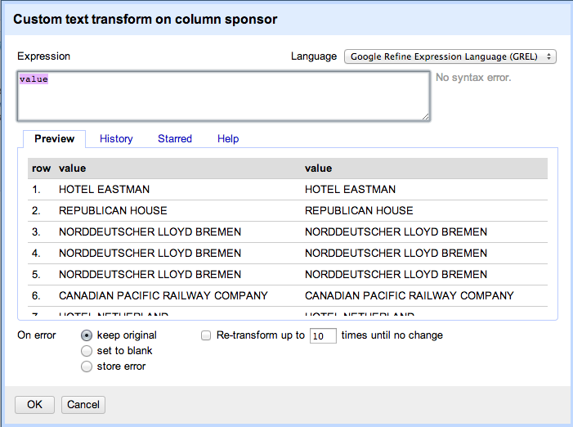
Advanced Transformations
Understanding Expressions:
https://github.com/OpenRefine/OpenRefine/wiki/Understanding-Expressions
GREL Cheat Sheet:
http://arcadiafalcone.net/GoogleRefineCheatSheets.pdf
Notes:
-- Before exploring on your own, I wanted to point out that you also have the option to do very sophisticated transformations using expressions.
-- Those of you familiar with regular expressions can try it out under “Edit cells → transformations”
-- Quick reference guide (created by Rod Whiteley)
-- If you aren’t familiar with using expressions, you might want to look at the introduction on Github to learn more.
-- Give time to play here

Slide 33
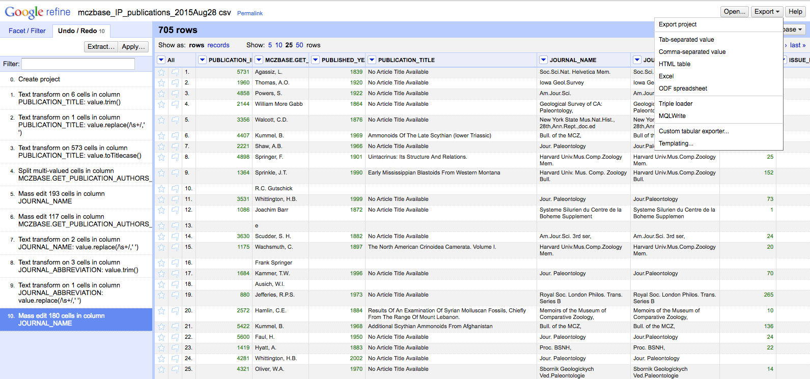
Exporting Your Project
Notes:
-- saving a project:
---- In OpenRefine you can save or export the project. This means you’re saving the data and all the information about the cleaing steps you’ve done. Once you’ve saved a Project, you can open it up again and be just where you left off.
-- exporting a project:
---- Go to the 'Export' button in the top right. Click 'Export project'. This will save a compressed file that you can then open in OpenRefine that contains all the data and steps.
---- for the data, notice usually 'Tab-separated values' or 'Comma-separated values' would be good choices.
---- BUT if you dowloaded the RDF extension there are also XML and Turtle serializations (which would be especially good to use for your linked data projects)

Slide 34
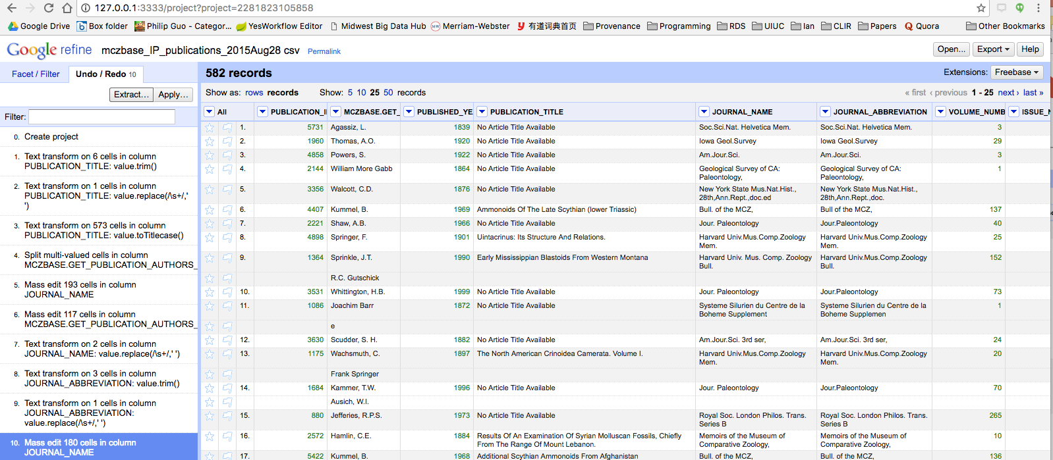
Extracting History as Provenance

Slide 35
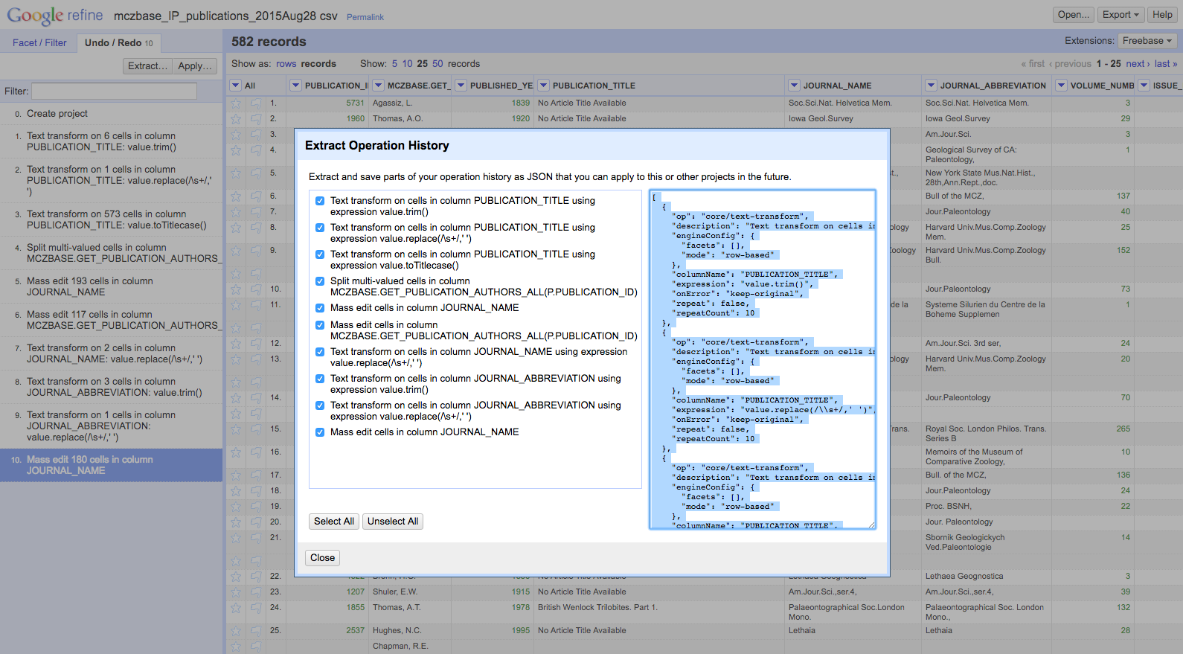
Extracting History as Provenance
Notes:
-- Chose which actions from your operation history that you’d like to extract
-- Then copy the JSON into a new text file

Slide 36
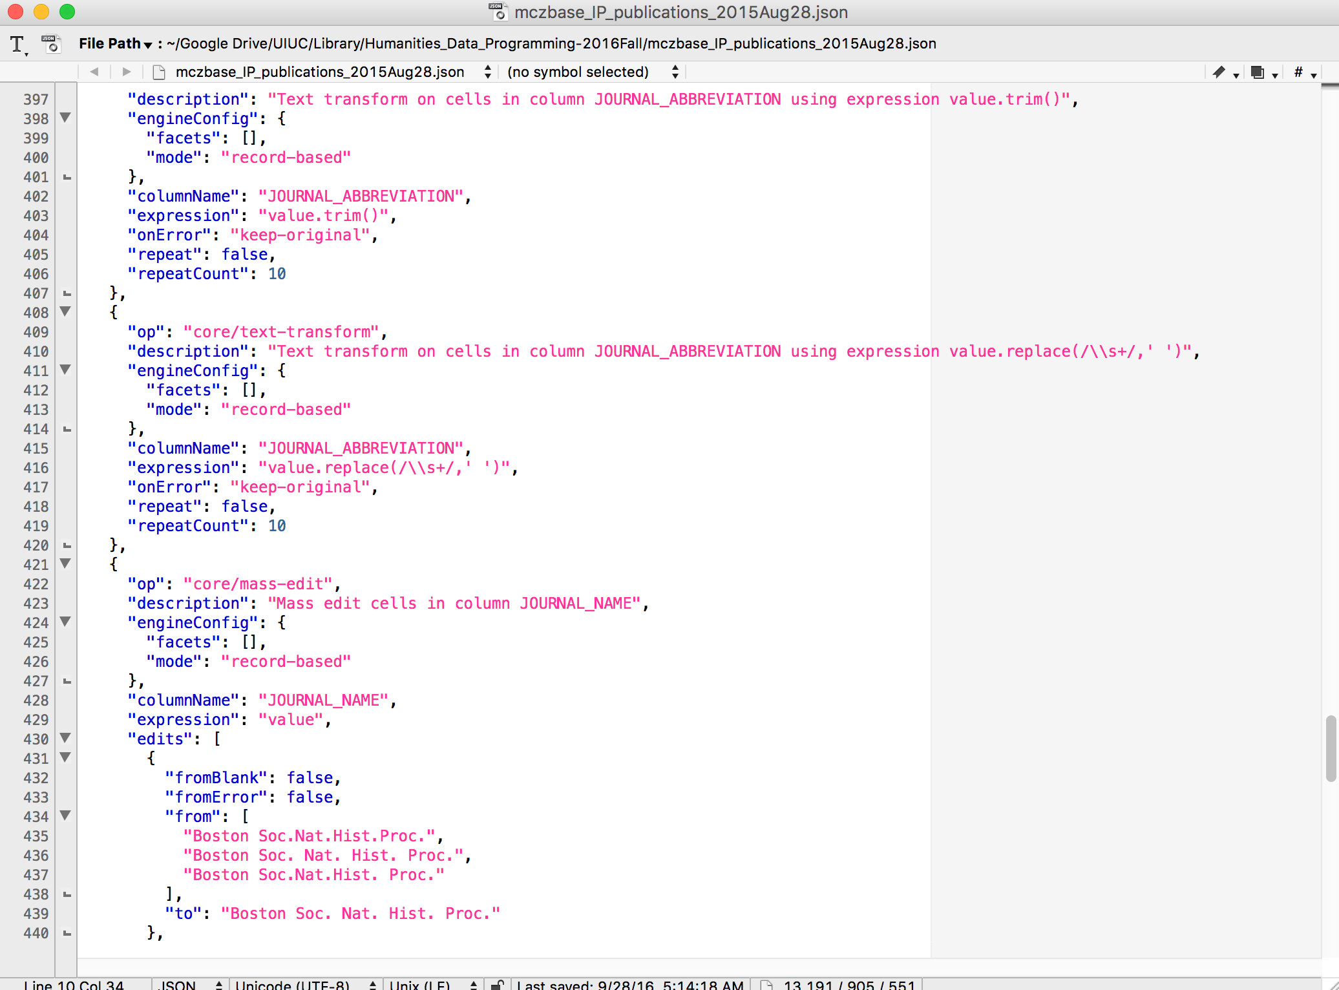
Extracting History as Provenance
Notes:
-- copy JSON into a new text file and save your work. (I’m using Text Wrangler here)

Slide 37
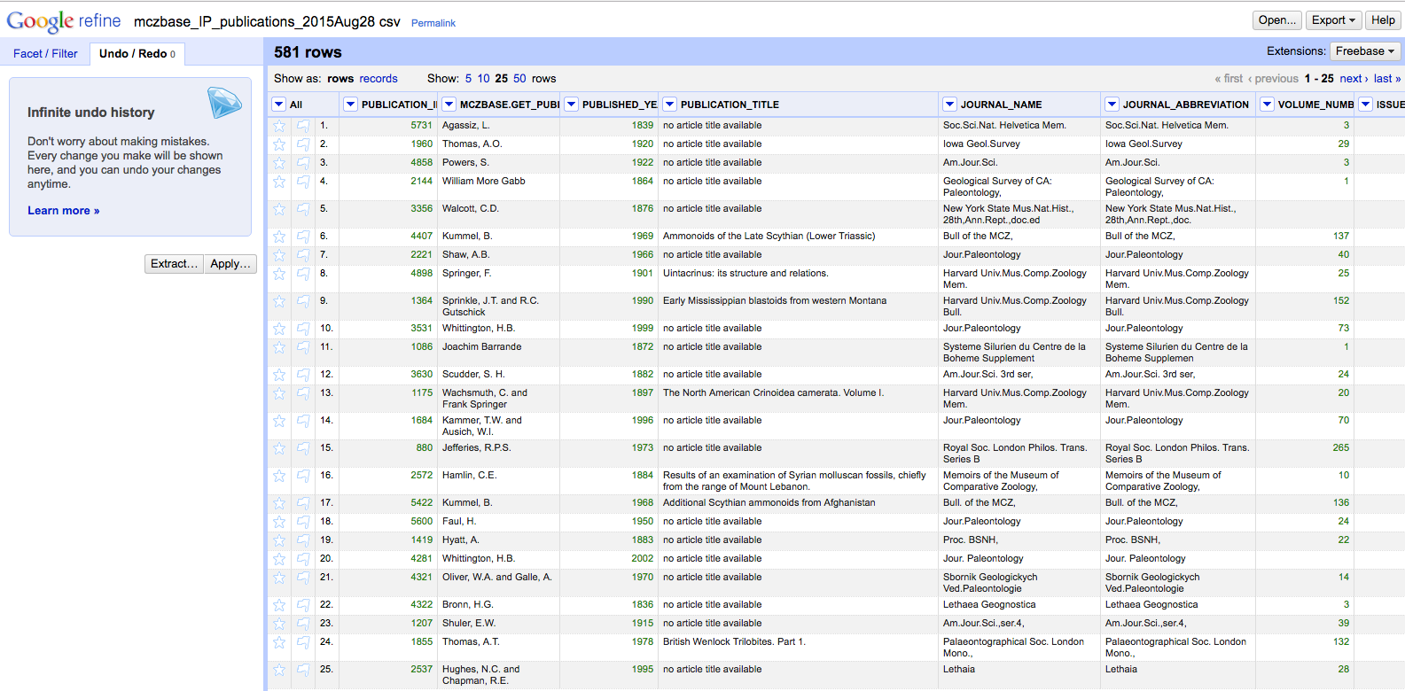
Applying JSON to New Project
Notes:
-- Now that you have your JSON file
-- You could re-open the menus data as a new project
-- and apply that JSON to replicate the same set of transformations,
-- Use saved JSON code to repeat an analysis

Slide 38
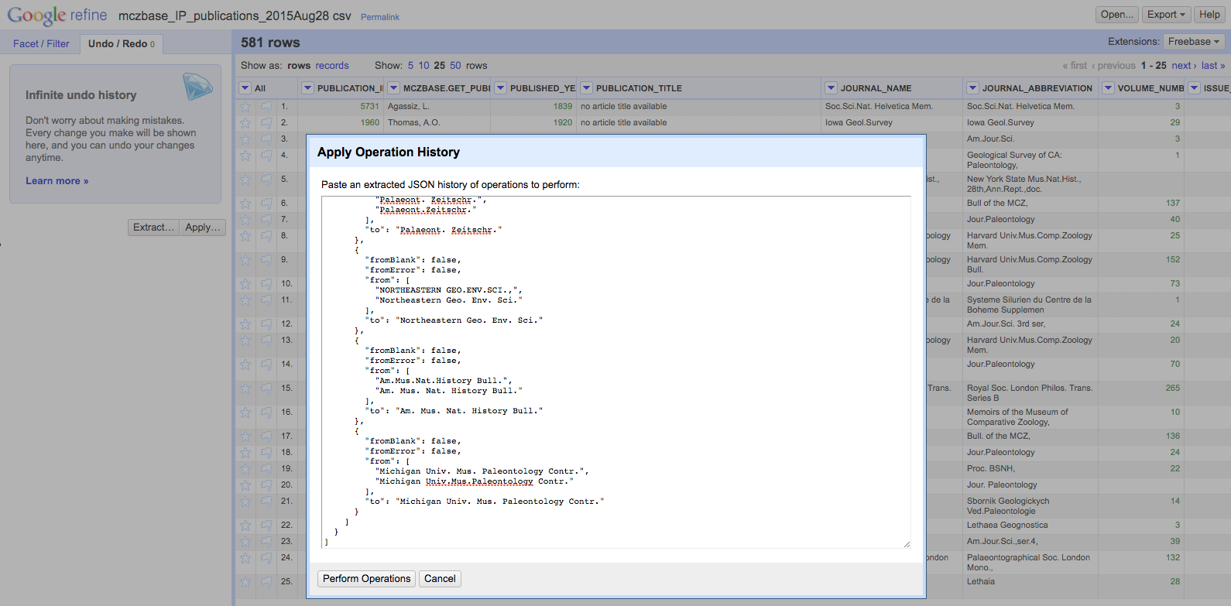
Applying JSON to New Project
Notes:
-- Copy your JSON from the text file you created into the blank text box
-- Click “Perform Operations”

Slide 39
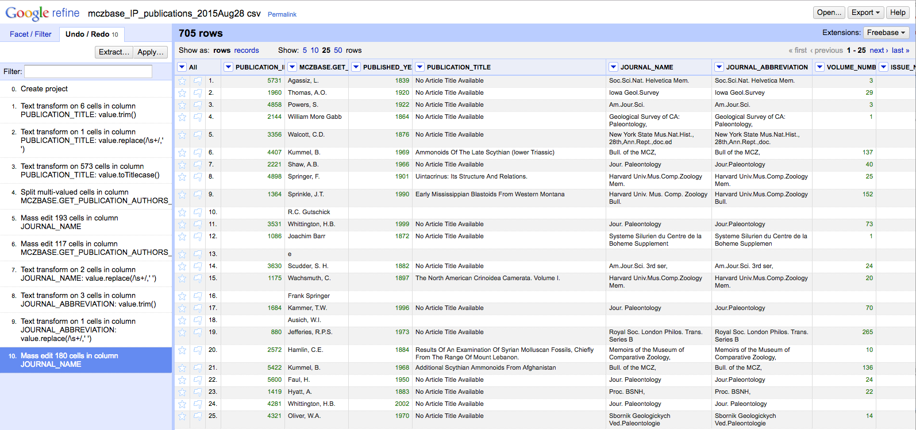
Applying JSON to New Project
Notes:
-- And now you can start your project having automatically completed a set of common transformations
-- This is useful if…
---- You want to document the changes you made to your data (protip: you do!)
---- You want to use a clean copy of your data set for multiple purposes
---- You have a series of files that have a similar organizational structure and you want to perform the same actions across multiple files

Slide 40

Up to Now…
Open Refine as a discovery tool in order to visualize, explore, manipulate, clean, and link your (big) data.
Highlights of OpenRefine
Creating a New Project:
Importing your data
Manipulating and cleaning your data
Reordering, renaming and sorting columns
Basic Normalization
Faceting and Clustering
Records vs. Rows
Exporting your work

Slide 41
Summary
Strengths:
Open source
Much more powerful than Excel (some functions easier to use)
Platform independent
Great history tracking (provenance!)
Can export commonly used functions for reuse (more provenance!)
Weaknesses:
Can be a little unstable; some queries are slow
Relies on many external services – some (Freebase) no longer supported
Some methods require light programming
Some tasks that are easy in Excel (adding new rows, find and replace) are more difficult/impossible in Refine
Notes:
Don’t neglect to get to this point and slide
Think about adding some more discussion points

Slide 42
Further Resources
Main project page (You can download the program here): http://openrefine.org/
Github repository (This is where the source code lives): https://github.com/OpenRefine/OpenRefine
Open Refine Documentation (AKA an extensive user manual): https://github.com/OpenRefine/OpenRefine/wiki/Documentation-For-Users
Online tutorial: https://bigdatauniversity.com/courses/introduction-to-openrefine/
Additional Reconciliation Services:
There are a several listed here. Nomenklatura & Reconcile-csv may be of particular interest: https://github.com/OpenRefine/OpenRefine/wiki/Reconcilable-Data-Sources
More on GREL: https://github.com/OpenRefine/OpenRefine/wiki/GREL-String-Functions

